Slide 1
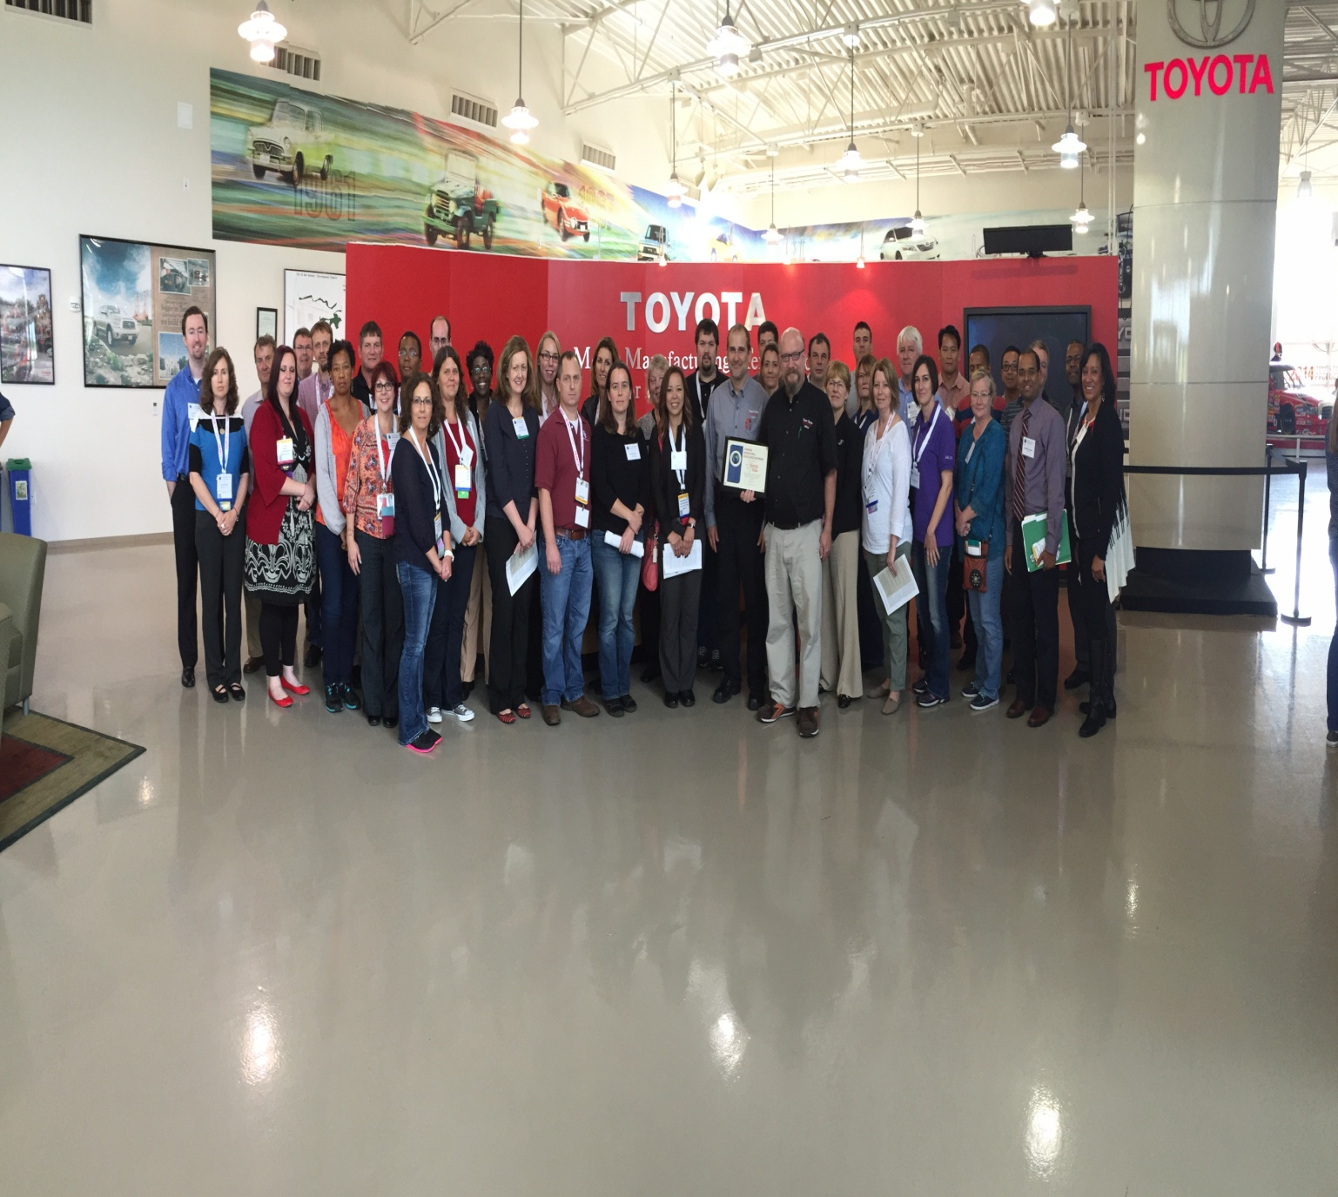
VOE-Network Business Meeting
Pre-AALAS Members Event
Charlotte, NC
October 30, 2015
VOE-Network Toyota Plant Tour
2014; San Antonio Texas

Slide 2
Agenda
Our Mission Statement
2016 Financial Statement
2016: Year Two in Review
Town Hall Meetings
Committee Activity
2017: Direction & Expansion
What’s on your mind?

Slide 3
Mission Statement
“The Vivarium Operational Excellence Network’s mission is to promote and exchange innovative methods and knowledge for managing laboratory animal programs around the world”
www.voenetwwork.com

Slide 4
2016 Financial Statement
The assets of VOE-N as of October 29, 2016 are $5625.87 ($2769.00 in FY15).
Total income through Q3 2016 was $8,881.00. This income was generated by membership dues.
Total expenses for this same time period were $6025.00.
Specifically,
Phase 4 website enhancements ($4425.00)
Website maintenance ($1000.00)
New Website & Plug-in ($600.00)
Pending:
501-C6 Filing ($2000.00)
AALAS Business meeting ($1000.00+)

Slide 5
2016: Town Hall Meetings
Town Hall Meeting #1: (approved)
Eliminate declining membership fees.
Create 3 Committees:
Governance Committee
Chair: Dr Donna Jarrell , MGH
Program Committee
Chair: Dr Sai Tummala, OMRF
Jarrod Nichol, LSSBB ,McGill
Eric Georgelos, Director, Yale
Membership Committee
Chair: Dr David Brammer, U of Houston
Town Hall Meeting #2: (approved)
New Website
Non-Profit Status
501-C6

Slide 6
2016: Governance Committee
Chair: Dr Donna Jarrell , MGH
Jennifer Booth, UPenn
Sharron Kirchain, Pfizer
Open
Purpose: set strategy and policies, oversee finances, serve members
Activities:
1) Draft by-laws and other governance SOP’s for approval by members
2) Appoint committee members
3) Review and distribute annual financial reports to members
4) Adjudicate any organizational conflicts that arise
5) Election of Committee members: by member institution representatives (1 vote per institutional member in good standing)
6) Number of Committee members: 4, including a Chair
7) Committee member qualifications: candidate’s employer must be a VOE-N member in good standing (i.e., all dues paid in full for all prior years of institutional membership)
8) Length of term: initially 2-4 years, later 3 years after rotating new members in effect

Slide 7
2016: Governance Committee
New Website
Features:
Open Source:
Virtual White Belt Training
Webinar accessibility past & future
Video Library (removed due to security)
Tools & tutorials
Coming Events
Communication Tools (email notices included)
Copyright Language needed for protection
Benefits:
$700.00/yr vs $4000.00+/yr
Flexibility & internal maintenance
Membership automation & support
Multiple content editors

Slide 8
2016: Governance Committee
Non-Profit Status
Currently State:
MGH as sole institutional benefactor
Membership Dues-supported
MGH Banking & dba Tax ID restrictions
Downside: using MGH non-profit status
No VOE-N autonomy
MGH liability & exposure
Goal:
Autonomous Non-Profit Status (501-C6)
Separate Bank Account
Formation of Board of Directors
Upside:
E-Commerce website for membership & Products
Invoicing with Tax ID #
Merge/affiliate with national organization (AALAS)
Corporate protection laws
Target to File:
January 2017

Slide 9
2016: Program Committee
Chair: Dr Sai Tummala, OMRF
Jarrod Nichol, LSSBB ,McGill
Eric Georgelos, Director, Yale
Open
Open
Open
Purpose: provide VOE-N members opportunities to learn lean management principles, exchange ideas and experiences with other members, and observe leading practices in organizations and companies in other industries besides lab animal care that are similarly devoted to continuous operations improvement
Activities:
1) Organize and execute entry-level (White Belt) training programs for vivarium personnel of all levels and backgrounds, regardless of VOE-N membership status
2) Plan informative and social events for VOE-N members, such as business meetings at national AALAS and gatherings at other industry venues, organize webinars with member or guest speakers, arrange for tours at participating programs and plant tours in other industries
) Number of Committee members: 6, including a Chair
) Appointment of Committee members: by the Governance Committee
)Committee member qualifications: candidate’s employer must be a VOE-N member in good standing (i.e., all dues paid in full for all prior years of institutional membership)
) Length of term: initially 2-4 years, later 3 years after rotating new members in effect

Slide 10
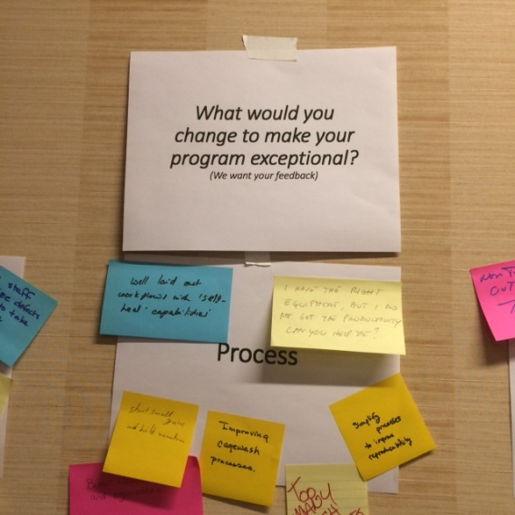
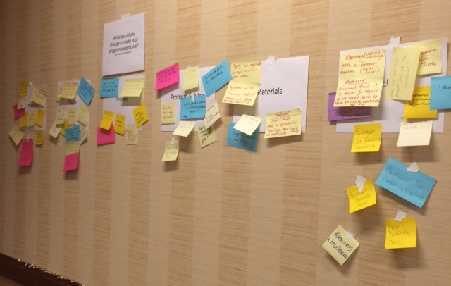
2015: Business Meeting:
“We want training”

Slide 11
2016: Program Committee
Webinars:
Learning Lab:
McGill University: “Visual Workplace”
MGH: “Vendor Partnerships”
VOE-N :”Virtual White Belt Certification & Training” (50+Certified)
Leadership Academy:
OMRF Leadership Series:
“Understanding Operational Chaos in Vivarium”
“People management and Team Building”
“Empowerment and Capability Building”
“Sustaining the Continuous Improvement Culture”

Slide 13
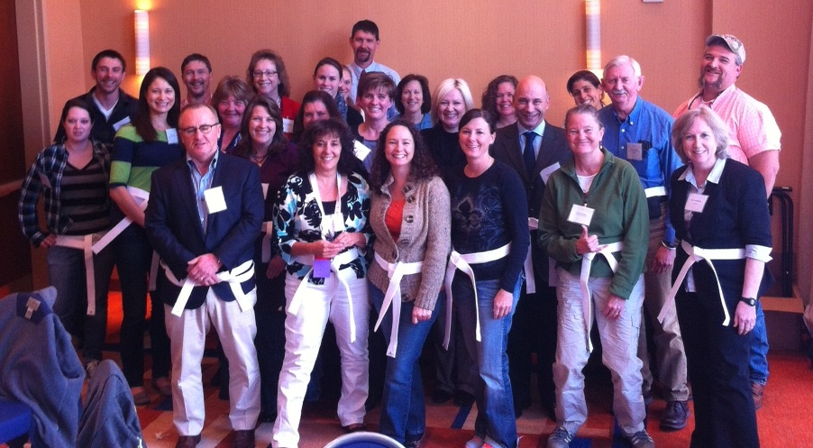
Lean White Belt Training
2015: 32 Participants
2016: 50 Participants
Class of 2013

Slide 14
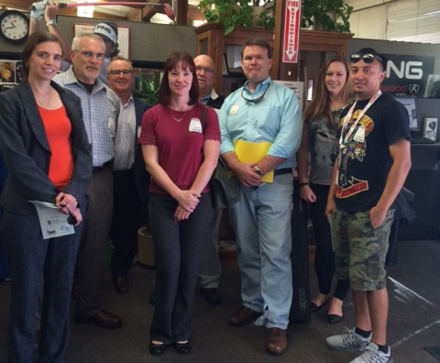
2015 AALAS VOE-Network Lean Factory Tour

Slide 15
2016 AALAS VOE-Network Lean Factory Tour
Sold out!

Slide 16
2016: Membership Committee
Chair: Dr David Brammer, U of Houston
Dr Steve Niemi, Harvard University
Open
Open
Open
Open
Purpose: recruit new VOE-N members and ensure current members’ needs are being served
Activities:
1) Establish and maintain recruiting materials for candidate member institutions; solicit candidates for membership from other members and networking leads; present benefits of VOE-N membership to those candidates and maintain contact until a decision is reached.
2) Conduct annual satisfaction survey and solicit feedback on membership value
3) Number of Committee members: 6, including a Chair
4) Appointment of Committee members: by the Governance Committee
5) Member qualifications: candidate’s employer must be a VOE-N member in good standing (i.e., all dues paid in full for all prior years of institutional membership)
6) Length of term: initially 2-4 years, later 3 years after rotating new members in effect

Slide 17
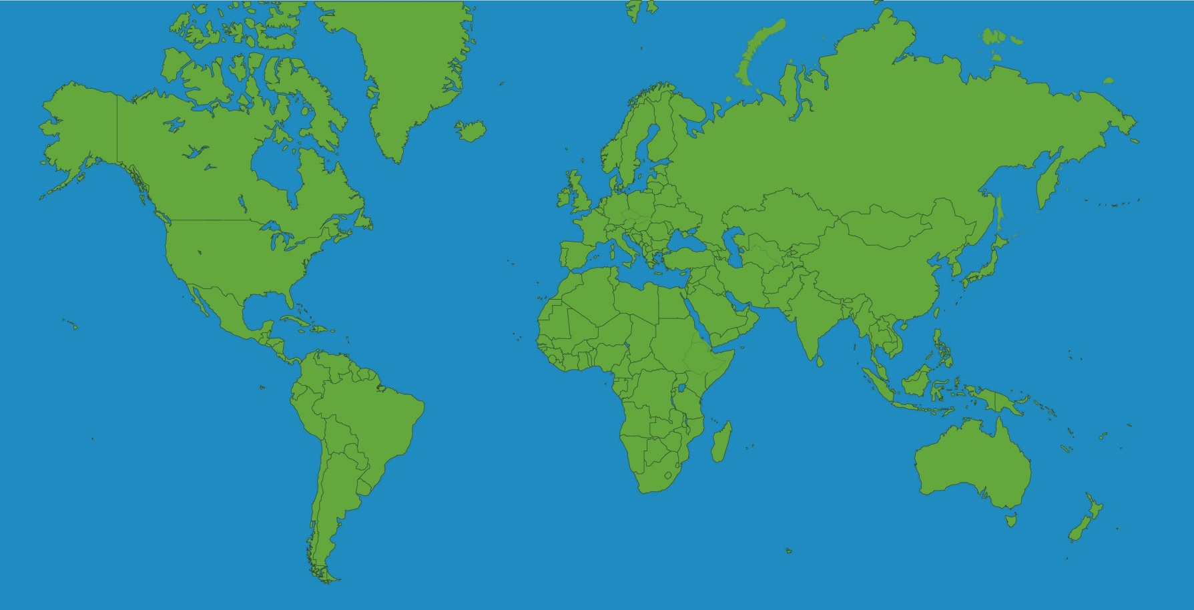
2016: Year 2 in Review
Membership Profile
20 Members (paid)
6 Countries
Brazil
Canada
Italy
Quatar
UK
USA

Slide 18
Members Institutions 2014 - 2016
Amgen CRIUCPQ US FDA McGill University, CA
Yale University University of Houston ACO Harvard University FAS Oklahoma Medical Research Foundation Allentown Tecniplast Fred Hutchinson Cancer Research Center Massachusetts General Hospital CCM Penn State Hershey College of Medicine ENVIGO Bioscience, UK Albert Einstein Hospital, Brazil Nationwide Children's Hospital Jackson Laboratory Mispro Bioscience Services The Research Institute at NCH National Eye Institute Weill Cornell Medical College, Quatar Emergent Biosolutions Eli Lily CBSET, Inc
University of Notre Dame University of Southern California Pfizer UNTHSC Scotts Pharmaserv Distributing Carleton University, CA

Slide 19
2017: Direction & Expansion
Non-Profit Status (501-C6)
ACLAM Leadership Training Partnership in 2017
Strategic Planning Session
Face-to-face vs Virtual
When?
VOE-N Survey Results

Slide 20
Open Forum
What’s on your mind?
What can we do better?

