Slide 1
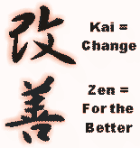
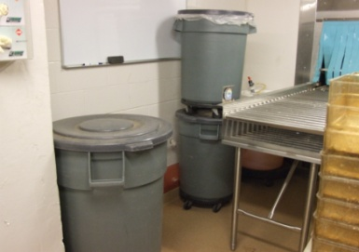
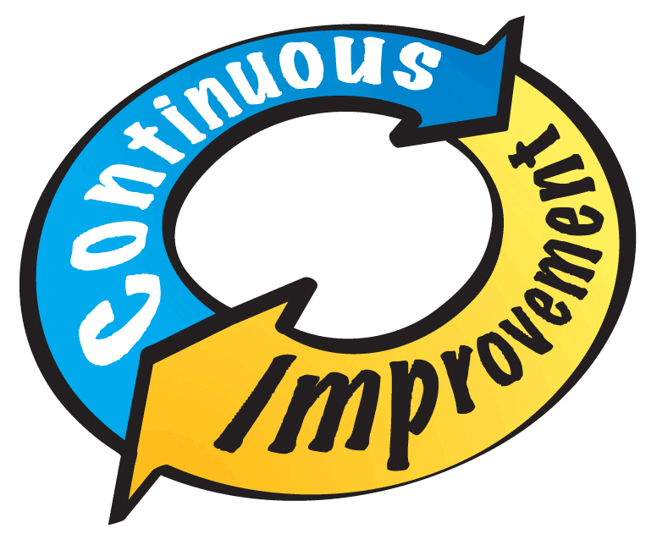
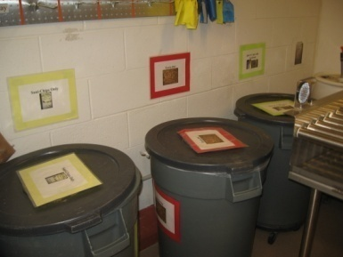
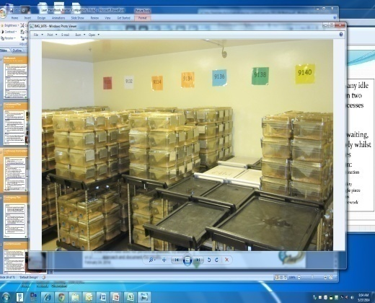
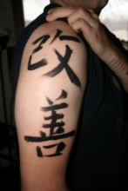
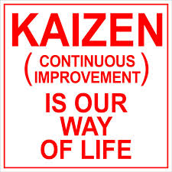
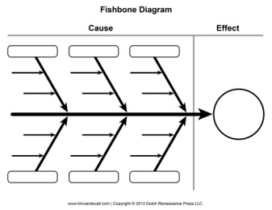
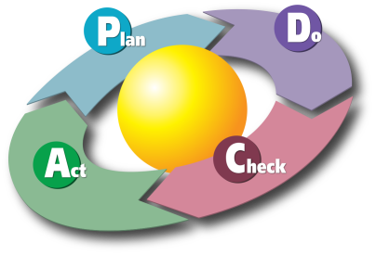
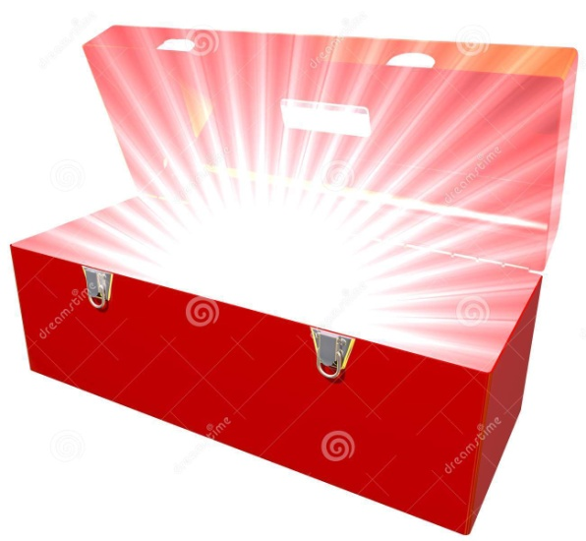
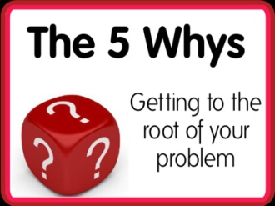
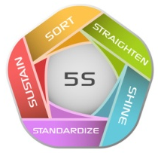
Continuous Improvement
(CI or Kaizen)
Definition:
The philosophy and process of making incremental improvements, no matter how small, and achieving the lean goal of eliminating all waste that adds cost without adding value.
Before
Before
Application:
At CCM, continuous improvement is part of the culture. When people understand it, they will automatically think about it during their tasks and constantly be looking for ways to make improvements. There are many tools to aid in continuous improvement, a major one being Plan-Do-Check-Act, which is used to help solve problems.
After
After
At CCM,
Purpose:
Continuous improvement teaches individuals skills for working effectively in small groups, solving problems, documenting and improving processes, collecting and analyzing data, and self-managing within a peer group. It pushes the decision or proposal making down to the workers and requires open discussion and a group consensus before implementing any decisions.
Lean Tool Box
Notes:
1

Slide 2
Voice of the Customer
VOC
Definition
Voice of the Customer (VOC) is a process used to capture and understand customer expectations and needs in order to provide the highest quality product at all times. The process should be proactive to meet real-time changing needs of the customer. It can be captured through interviews, surveys, focus groups, requests, observation, or suggestion/complaint logs.
Housing Space,
Facility Access,
Where are my cages???
Application
Every CCM employee is expected to politely greet customers when appropriate and respond in a timely manner to questions, requests, concerns, and, yes, even complaints. Our primary customers are the Principle Investigators (PI) and research staff.
CCM’s Customer Service Hoshin Team passively tracks customer feedback monthly at the leadership level. Analyzing this data allows CCM to react, understand, and identify areas to continuously improve the customer experience.
Purpose
Understanding the VOC, assists CCM in reducing Non-Value Added services and increasing Value Added services. Ultimately this contributes to the CCM mission to “provide reliable, affordable, and responsive laboratory animal care and research services in pursuit of scientific knowledge and medical breakthroughs”.

Slide 3
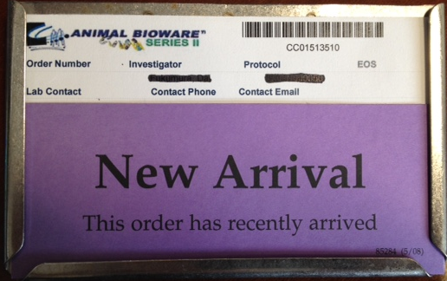
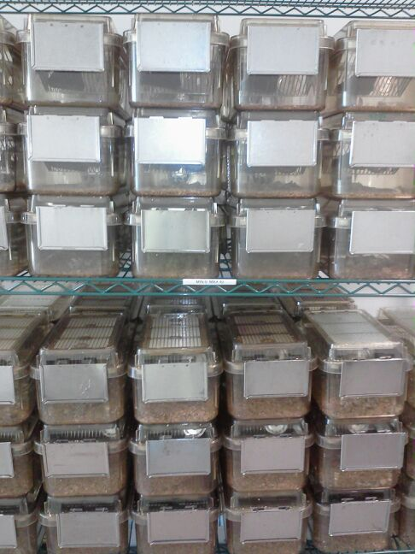
Value-added
(VA)
Early Notice to the Customers that they have pups: Pro-active Customer Service!
Definition:
Any action within a process that meets all 3 of the following criteria: 1) The customer is willing to pay for this activity.
2) It must be done right the first time.
3) The action must somehow change the product or service in some positive manner.
Visual marker for the customer that they have new arrivals: Pro-active Customer Service!
Application:
CCM staff increase value-added services when eliminating waste through utilization of the problem-solving boards, continuous improvement, and organizing the workplace (5S). In this way tasks become easier and the savings can be passed on to the customer.
Overcrowded Cage Email: early warning signal to the customer to prevent them from having to pay CCM for the service!
Purpose:
When we are able to identify and eliminate non-value-added steps we are delivering better service to our customers, better care for our animals, and more timely medical breakthroughs.
Ready-to-go Full Setups for the Customers to use when exactly when and where they need them!
Notes:
3
3

Slide 4
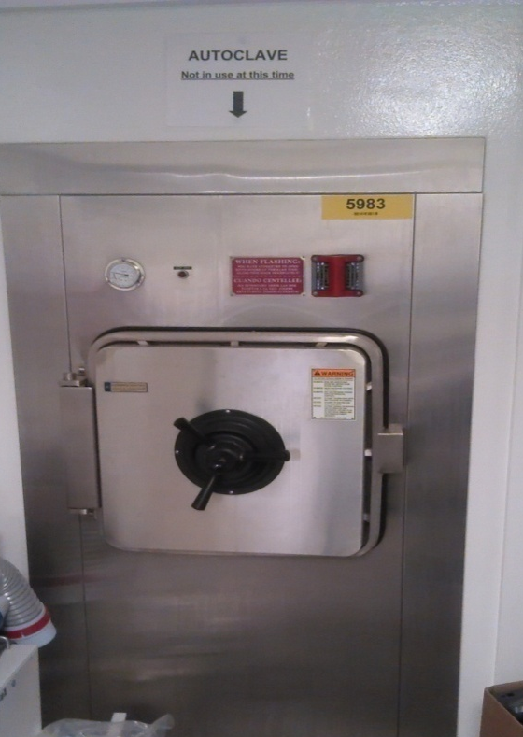
Non value-added
(NVA)
Definition:
Non Value-Added refers to activities or investments that generate zero or no return (may even cost money) and do not create value to a process or conformance to customer specifications. NVAs should be eliminated, reduced, or simplified when possible.
NVAs can be obvious or invisible.
Application:
NVA activities at CCM may include waiting for supplies, copying data, any re-work, counting supplies, walking around to locate supplies and traveling on the shuttle.
Purpose:
Identifying NVA activities and eliminating them reduces the cost of service to a customer to the value-added activities they requested and for which they are willing to pay.
Example: Autoclave “not in use” is generating zero return and adds zero value to any process
Notes:
4
4

Slide 5
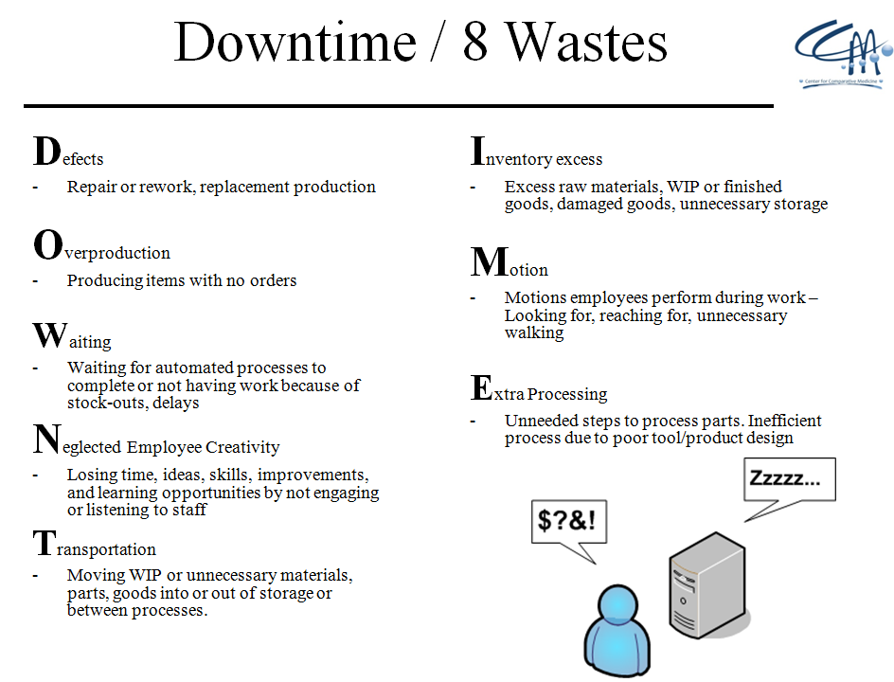
8 WASTES:
(“DOWNTIME”)
Definition:
The classification of the most common wastes in operations and processes.
Application:
Waste can easily be detected when observing workers walking to gather supplies, re-doing a task, moving material, waiting for information, cleaning, de-gowning, etc.
Purpose:
“Waste” causes more work for the RAS and less time for more important tasks the customer pays us to perform.
Waste also causes worker frustration, exhaustion, lost productivity, slows down research, and prevents CCM from reaching its goals.
“What stinks
about this process?”
“Why?”
“Where is the waste?”
Notes:
5

Slide 6
Andon Cord
(“Pull the cord” / Problem Escalation)
Definition:
Any type of signal to communicate that a system is not working properly or if there is a problem. This allows the issue to be fixed immediately, and not passed downstream to the customer.
Application:
For any process that is not working, we use an andon cord to bring problems to the surface and to eliminate waste.
Question everything and “pull the cord” if:
You see something that is “a pain”!
A Problem is too big for the team to resolve
A Problem is taking more than 14 days to resolve
You see a safety issue
Follow-up on your Andon within 7 days to verify clarity.
Purpose:
To identify Problems that require assistance, immediate attention or issues that need improvements at CCM.
“Find a problem, Fix a problem, Make it go away”
Notes:
6

Slide 7
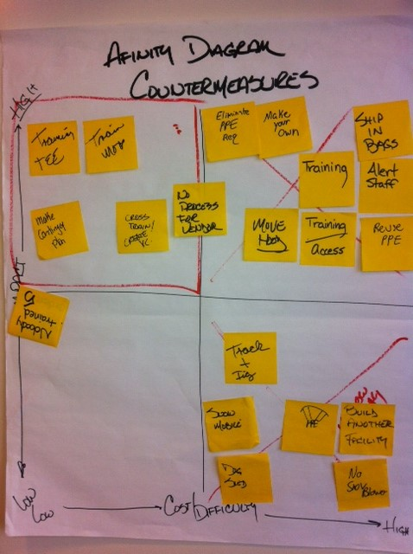
Affinity Diagram
Definition:
Affinity Diagrams are used to visually prioritize and cluster problems, countermeasures, ideas or issues.
“High Impact/
Low Difficulty”
= Best place to start or “Just do it”
“High Impact/
High Difficulty”
= Needs time, money, assistance
or “Not right now”
Application:
Problem Solving Board
Individuals can identify problems or ideas on opportunity cards
The team will then place the card on the affinity diagram, based on its impact and effort/cost.
Fishbone (refer to Fishbone form)
After problems or causes have been identified on sticky notes and organized on the fishbone, the team then brainstorms countermeasures to make those problems or causes go away. The team can then appropriately place the countermeasure on the affinity diagram.
The best results are achieved when the activity is completed by a cross-functional team of stakeholders.
Impact
“Low Impact/
Low Difficulty”
= Low priority, but maybe worthwhile
“Low Impact/
High Difficulty”
= Best to avoid
Purpose:
Affinity diagrams are used as a visual tool to enable all stakeholders to become an active participant in prioritizing team tasks and initiatives. The process requires everyone to become immersed in the discussion, which has benefits beyond the deliverables.
Cost/ Effort
Notes:
7

Slide 8
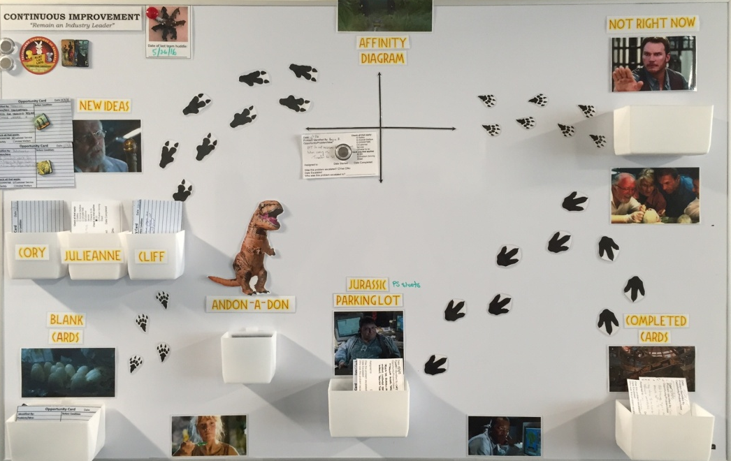
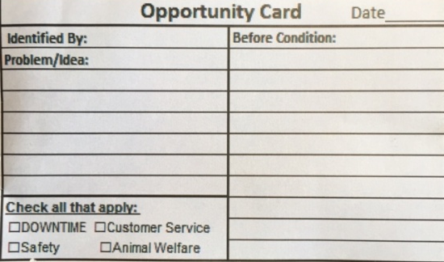
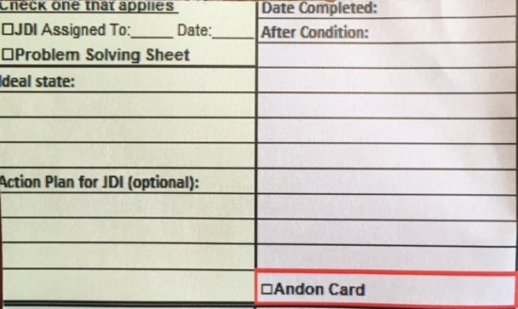
PDCA
(Plan, Do, Check, Act)
Definition:
PDCA is an acronym for “Plan, Do, Check, Adjust/Act” cycle of continuous improvement. It is the four-step method used by CCM to eliminate problems and waste.
P
Application:
In the “PLAN” stage, the Team carefully identifies the current state of the problem with metrics (footsteps, time, touch-points, bending, cost). The Team then identifies the ideal state (reduction of the metrics above). The Team analyzes the problem using “Root Cause Analysis” techniques such as the 5-Whys, Fishbone Diagram, surveys. The Team then brainstorms appropriate Countermeasures to eliminate the “root causes”.
In the “DO” stage, the Team will test the countermeasures that they feel will eliminate the problem in a controlled pilot group .
In the “CHECK” stage, the Team will examine how their countermeasures behaved; did it get better or worse?
In the “Adjust” stage, if the problem was not eliminated, they will revisit the problem and analyze once again and test different countermeasures. If the problem was eliminated, they move to the “ACT” stage.
In the “ACT” stage, the new process becomes the new standard and should be rolled out to all teams involved with the process.
D
A
P
C
Purpose:
PDCA is the most reliable technique for teams to ensure problems are being solved, that the problems do not come back, and that other problems are not being created.
A
D
Notes:
8
8

Slide 9
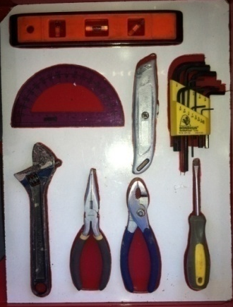
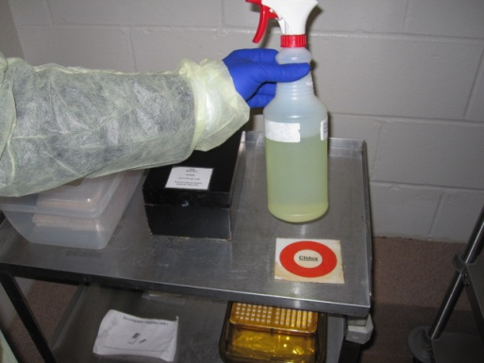
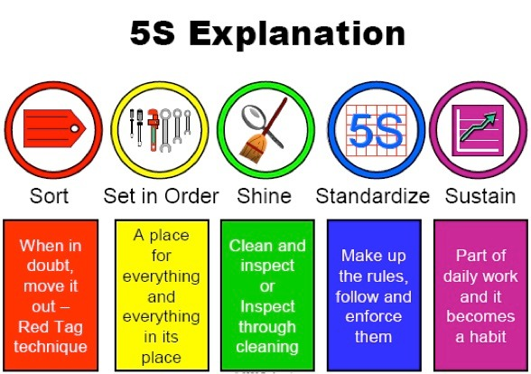
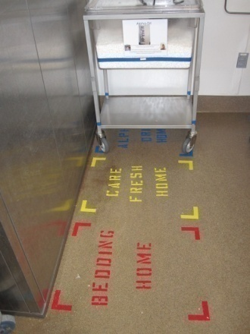
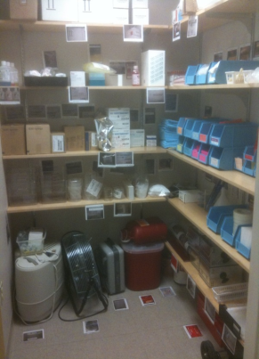
5S: Sort, Straighten, Shine, Standardize, Sustain
Definition:
5S is a workplace organization system based on 5 steps: Sort, Straighten, Shine, Standardize, and Sustain. It is also a guide in evaluating current workspaces within CCM.
Application:
Purpose: The 5S process ensures that workplace organization is a social contract that supports the worker to perform in the most efficient way. It relies on collaboration and respect from all users of a space.
5S makes items and information easier to locate and processes easier to understand at the point-of-use.
5S supports workplace organization that makes work flow, and visually highlights problems, abnormalities and waste in a process.
Notes:
9

Slide 10
Standard Work
(also, Leadership Standard Work ; LSW)
Definition:
Standard Work is a schedule or defined tasks.
It is the “What needs to be done” component of daily, weekly or monthly routines at all levels of an organization.
Application:
Standard Work is often created by teams doing the work collecting and sharing best practices, mapping out routines, observing others when doing work then prioritizing the order of the tasks or routines.
Standard Work for a(n):
- RAS may be found on Door Sheets, Room Task Sheets, Checklists, or daily VPP Board Assignments.
- Team Lead may be conducting a Sunrise Meeting at 7am, checking the transport requests at 10am, checking on team members at 1pm.
- Facility Manager (LSW) may be to conduct a gemba walk at 8:30 everyday, conduct Team Lead meetings at 11:00 and walk the floor again at 1:00.
- Senior Leadership Team members (LSW) may be weekly Key Performance Indicators, review daily safety reports or attend weekly huddles.
Purpose:
Standard Work helps CCM define today’s best sequence of critical work to ensure the highest quality, consistency, productivity, and safety of staff and to the animals we serve.
Standard Work establishes assurance and predictability to the important tasks and responsibilities that support the CCM Mission and commitment to our customers.
Notes:
10
“A “Standard” is a method or reliable procedure is made up of only those elements that, when not followed results in a predictable defect or waste.”
10

Slide 11
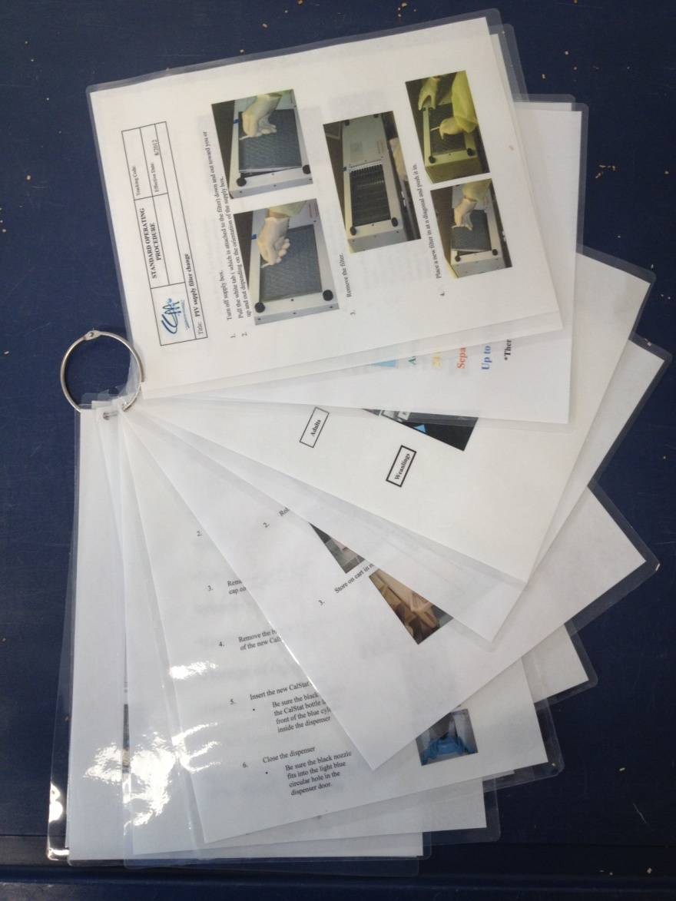
Standard Operating Procedure
(SOP)
Definition:
Standard Operating Procedures are detailed, written instructions on “how” to perform a process.
Application:
CCM SOPs are used to capture all the detailed steps in a process that can be or are applied across all facilities, such as Euthanasia and MIT.
Facility-based SOPs describe facility-specific processes, such as operating or maintaining equipment that is unique to a facility.
CCM employees can improve SOPs through providing feedback, using Opportunity Cards, brainstorming and team collaboration. If teams agree on a “better way” to improve a procedure, the SOP can be adjusted.
To suggest changes, edits or new CCM SOPs, please contact your manager or supervisor.
Purpose:
SOPs help to ensure that all critical processes are performed in the same way to maintain or improve consistency, customer service, safety, regulatory compliance and quality animal care across the department.
Notes:
11
SOPs detail the regularly recurring work processes that are to be conducted or followed within an organization. They document the way activities are to be performed to facilitate consistent conformance to technical and quality system requirements and to support data quality. They may describe, for example, fundamental programmatic actions and technical actions such as analytical processes, and processes for maintaining, calibrating, and using equipment. SOPs are intended to be specific to the organization or facility whose activities are described and assist that organization to maintain their quality control and quality assurance processes and ensure compliance with governmental regulations.
If not written correctly, SOPs are of limited value. In addition, the best written SOPs will fail if they are not followed. Therefore, the use of SOPs needs to be reviewed and re-enforced by management, preferably the direct supervisor. Current copies of the SOPs also need to be readily accessible for reference in the work areas of those individuals actually performing the activity, either in hard copy or electronic format, otherwise SOPs serve little purpose.
1.3
11

Slide 12
Visual Controls
(VCs, Visual Workplace, AIB)
Definition:
Visual Controls are indicators or reminders that provide critical information at the point of use to encourage CCM and our customers to act in a standard way.
Application:
Written instructions and signs are helpful, but minimal text should be used when creating them, as pictures are most effective. VCs typically take 4 steps (or less) to perform.
NOTE: For critical operational processes that require greater than 4 instructional steps to perform, an SOP may be required. (See “Standard Operating Procedure”)
Purpose:
VCs help answer questions when new to area or no one is around to ask. They are directed at who is responsible for following the instructions.
VCs help to ensure that all critical processes are performed in the same way to maintain or improve quality animal care across the department.
Notes:
What you need to do now.
Is it obvious what is going on?
If you were a stranger, could you work out what is happening, and how well things are going?
If there a lot of clutter?
Is there little useful up to date information displayed in an eye catching interesting, memorable way.
Is there good signage. Is it obvious where things should go?
12

Slide 13
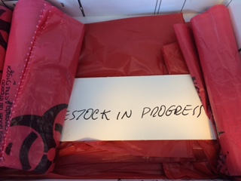
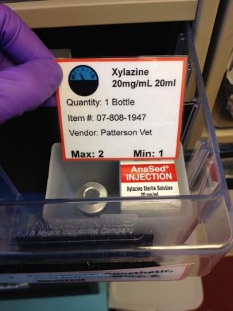
Kanban
Definition:
A Kanban is the visual signal in an MRS system that is triggered by a depletion of product, a need for attention, assistance, parts, or a need for additional inventory. The term is Japanese for “signal” or “signboard.”
Application:
Kanban signals are used at CCM to indicate WHEN items need to be replenished or WHEN actions need to be taken and can be found wherever supplies are needed.
Considerations for creating a kanban include reorder time, min/max, ordering information, etc.
Purpose:
Kanbans are used to ensure that information or materials are consistently at the point of use so that work can continue and is never interrupted.
Notes:
13
13

Slide 14
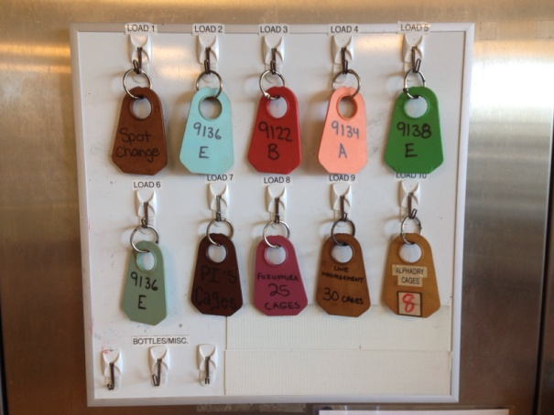
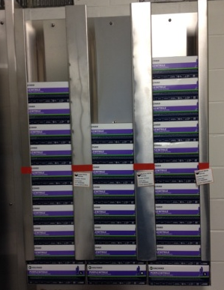
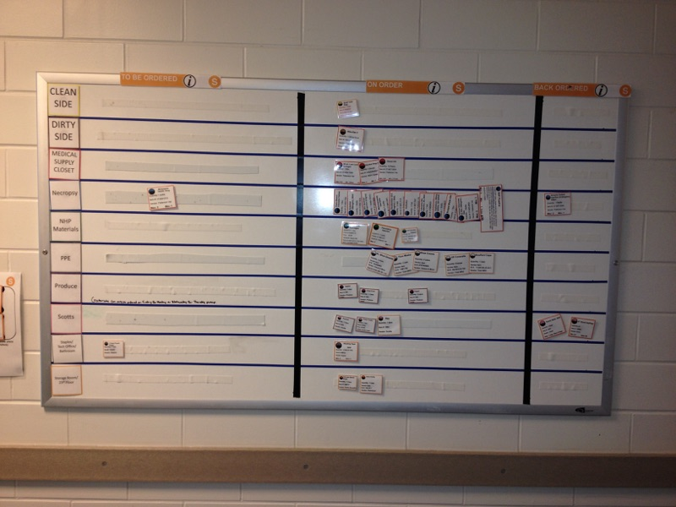
Material Replenishment System
(MRS)
Definition
MRS are systems designed using visual tools to automatically “pull” or trigger more materials when they are needed.
149-9 Cage Replenishment System
Application
An effective MRS system should satisfy the following criteria:
Can it be managed without counting?
Is it simple and visual?
Does it ensure that material never runs out?
Step 1: RASs request cages by placing color-coded tags for the next days cage change. (Pull System)
Step 2: Clean Side technicians transfer the tags to the daily Clean Side Production Board
Step 3: Clean Side assembles orders placed and returns kanbans.
Purpose
Material Replenishment Systems ensure that all necessary items required to support a process or perform a task are available exactly at the time needed, in the proper place, and quantity required to provide value to the customer.
EDW Material Replenishment System
Step 1: Kanban is pulled when re-order point is reached
Step 2: Kanban is placed on the “To Be Ordered” section
Step 3: Once ordered, the Kanban is moved to the “On Order” section
Step 4: Material arrives, kanban is moved to original location or “Back Ordered”
Notes:
14
14

Slide 15
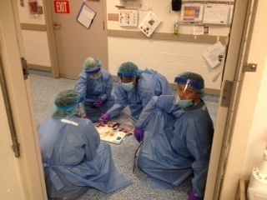
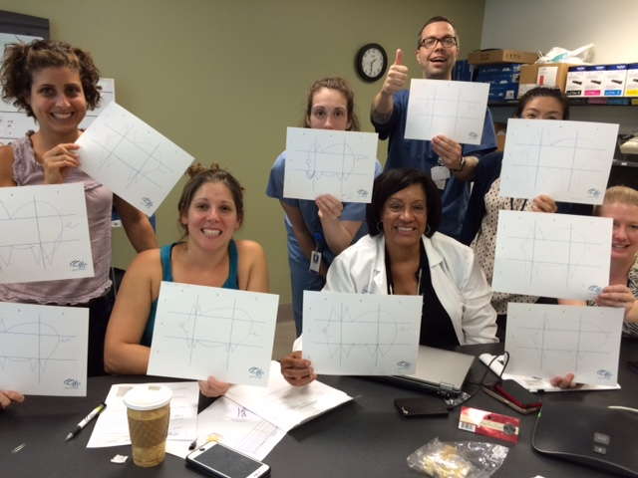
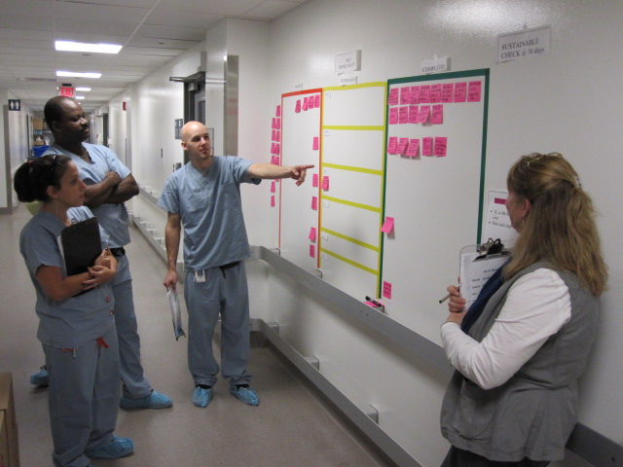
Total Employee Engagement
(TEE)
Definition:
An engaged employee is someone who applies and expresses themselves during daily work.
Application:
All CCM employees are encouraged to utilize their creative strengths to continuously improve their work daily; finding one tiny opportunity for improvement is everyone’s role.
How can I be engaged?
Daily Workplace Organization (5S), Team Problem-solving, sharing ideas, joining committees and looking for waste. Try something, say something; anything is possible. Thinking about ways to make work life easier is far more enjoyable than struggling over and over to get work done.
TEE = “Everybody, Everyday”
Everybody, Everyday!
Purpose:
Our engagement demonstrates that we are committed to the CCM Mission, Vision, and that our contributions help accelerate cures for our friends and family.
TEE results in high employee and customer satisfaction, creates a desirable workplace environment and moves research forward.
Notes:
15

