Slide 2
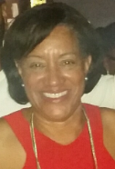
Your Host, Dr. Donna Matthews Jarrell, DVM
Director, Center for Comparative Medicine
15 years in CCM
General Managers Program, Harvard Business School
Introduced Operations Excellence through Lean Management in 2005

Slide 3
Kimberly Bundschuh, LAT, Team Lead
Kimberly Bundschuh
BS Animal Sciences and Business, University of Rhode Island
Rodent team lead
Coordinates daily tasks and manages work flow for team members, encourages continuous improvement and problem solving, and provides animals with exceptional care everyday.
3 years in lab animal care and research support at the Center for Comparative Medicine at MGH.

Slide 4
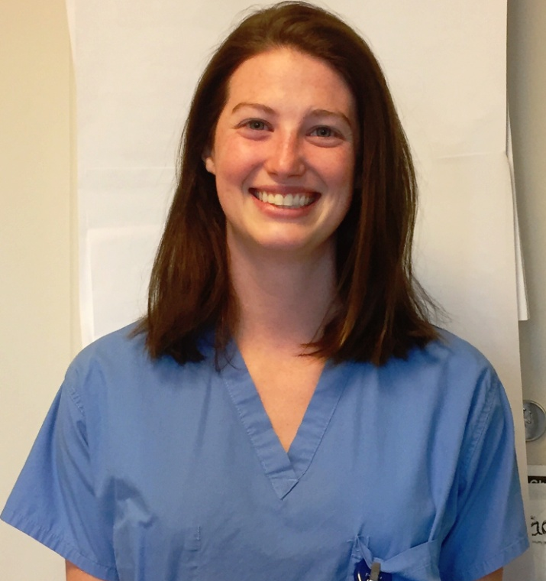
Caroline Warren, LAT, Team Lead
Caroline Warren
BSAM (University of Rhode Island), RLAT
Non-Human Primate Team Lead
Create daily husbandry schedules for team members as well as work alongside with facility manager, users, enrichment technicians and veterinarians to ensure that the facility is always inspection ready and that our animals are receiving the best care possibly.
Has been a member of CCM and the animal research community for 4 years come September.

Slide 5
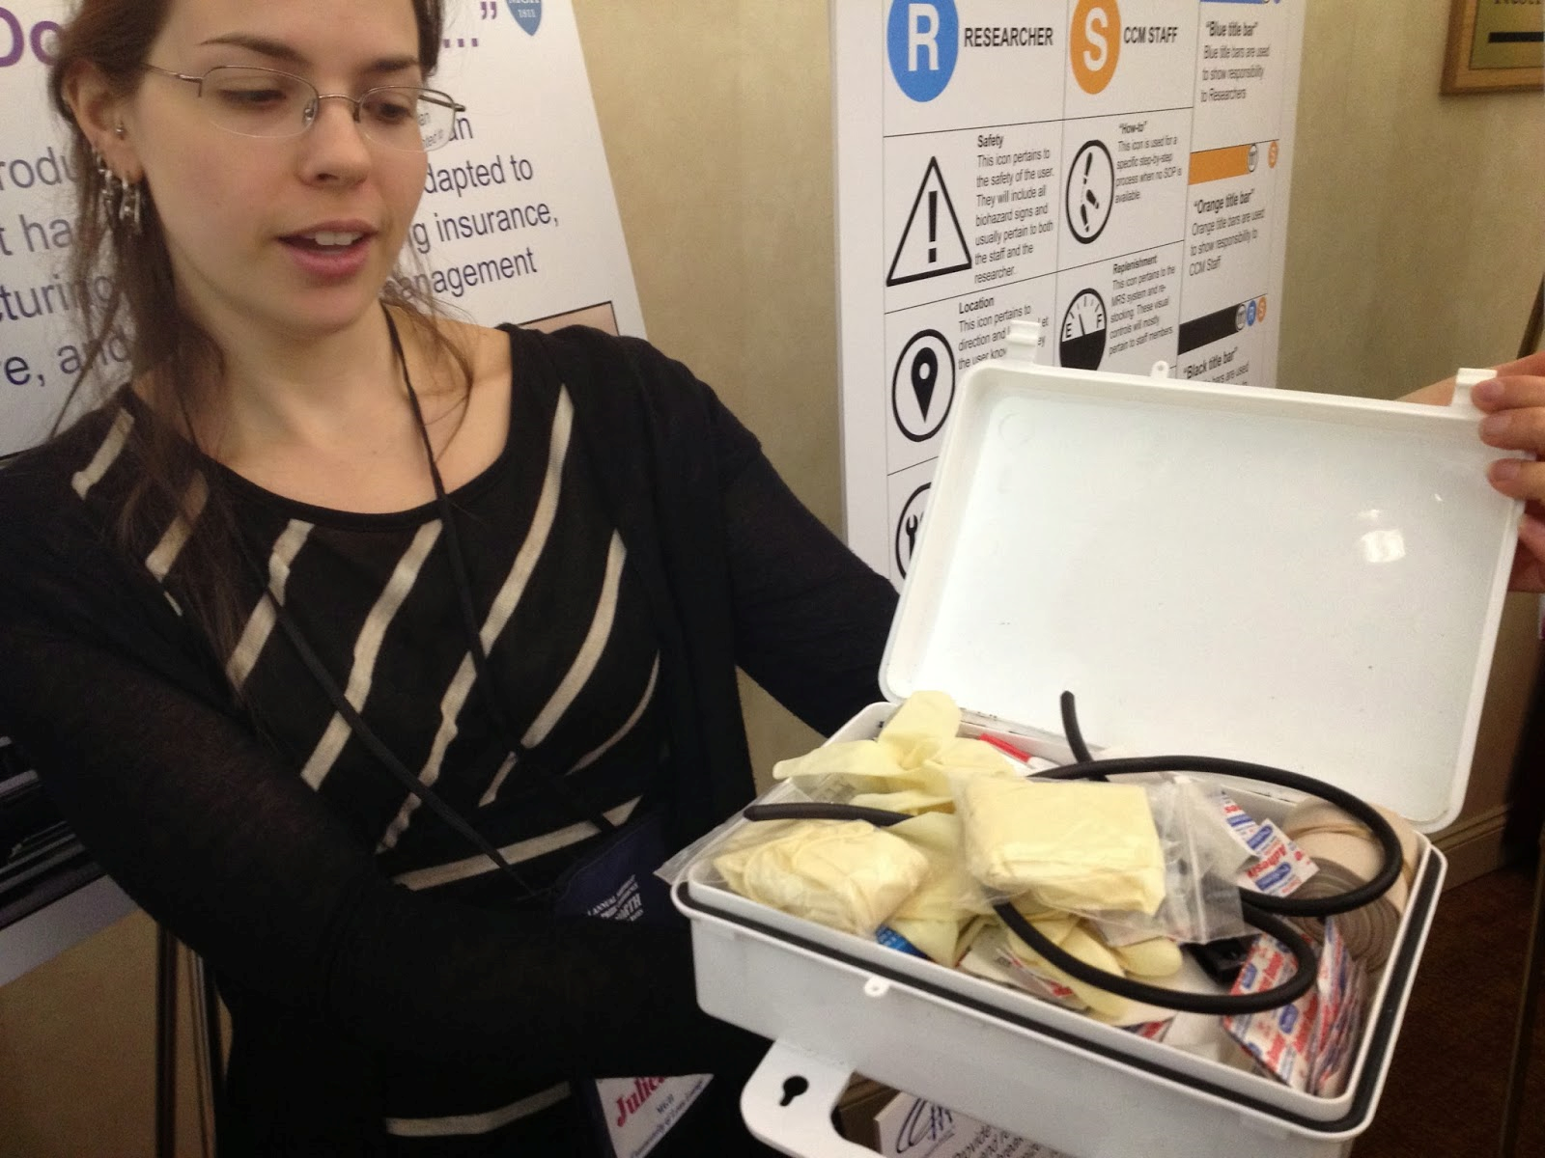
Julieanne Brandolini, LAT, Training Program Manager
Julieanne Brandolini
BS Equine Science
Training Program Manager
Oversees the training for new hires, team leaders and animal users
9.5 years in Lab Animal Care/Research Support
9.5 years at CCM

Slide 6
Our True North
CCM Mission
- Provide reliable, affordable, and responsive laboratory animal care and research services in pursuit of scientific knowledge and medical breakthroughs
- Avoid or minimize pain and distress in animals under our care
Maintain a fulfilling, respectful, and safe workplace
CCM Vision
To remain an industry leader through continuous improvement and share our innovations with others
CCM Strategy
Our mission and vision will be pursued in a relentless, programmatic manner by all levels of the department to improve quality and eliminate waste.

Slide 7
CCM’s Lean Journey - 2005-Present
CCM Begins
First BSC,
First VSM &
Kaizen Event
PDCA
Staff
Training
Lean Boosting 2010
Standardization;
1st TPS mgmt
training
Lean
Knowledge
boost
Formal Gemba Walks; All Facilities/Areas
2002
2004
2006
2008
2010
2012
2014
2016
2017
CCM Pre-AALAS Symposia
ESL;
Bar-coded
Cage Cards
CCM Reorg;
Created Teams
5S
Information Management
CCM Reorg;
Leadership Change
Expanded Ops Leadership;
Doctoral Staff Reorg; Customer Dissatisfaction Survey
Focus on KPIs

Slide 8
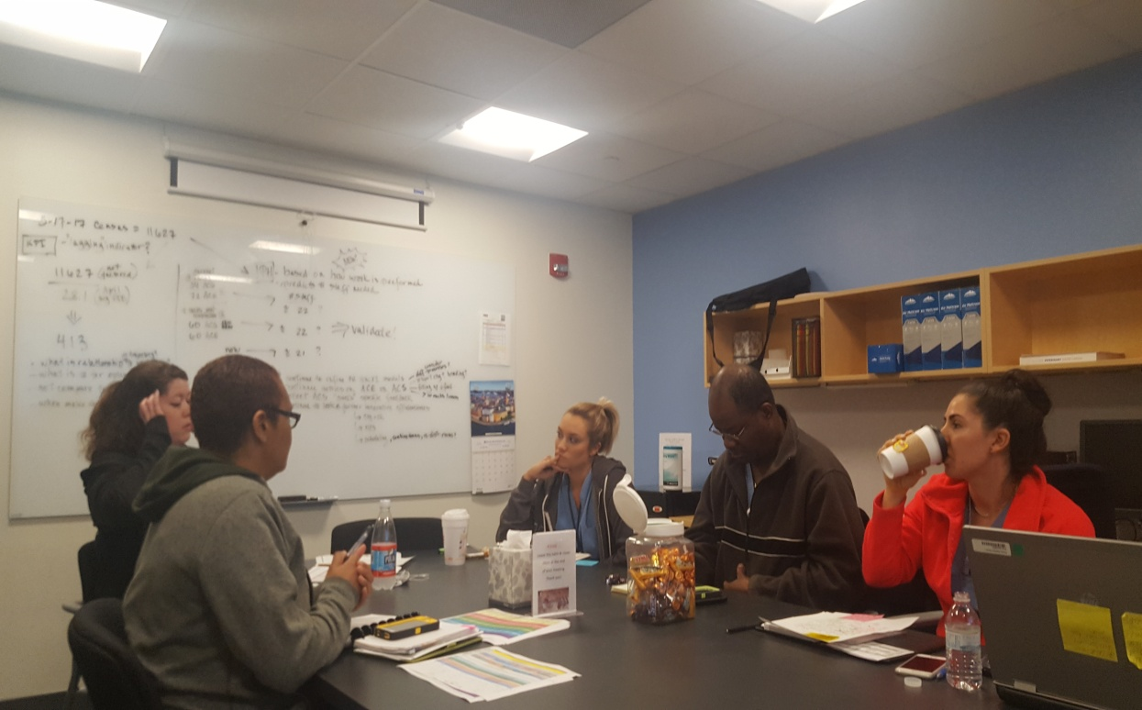
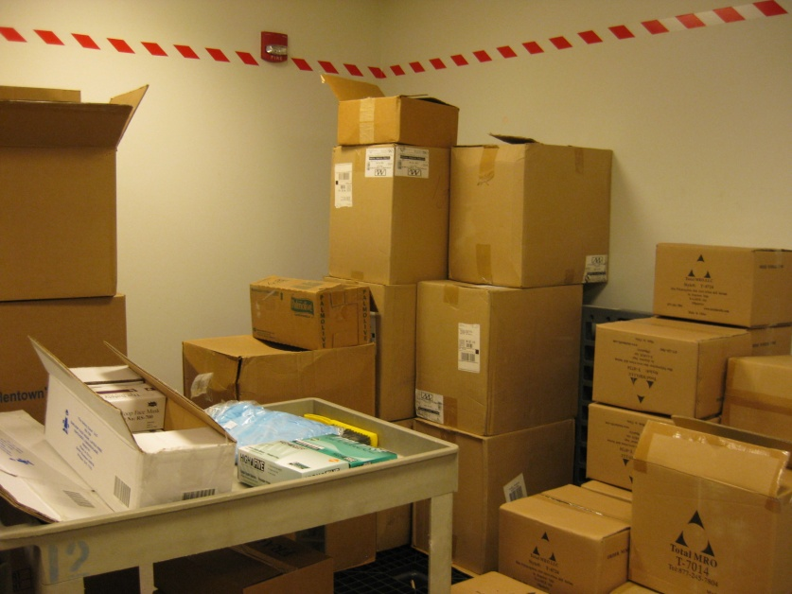
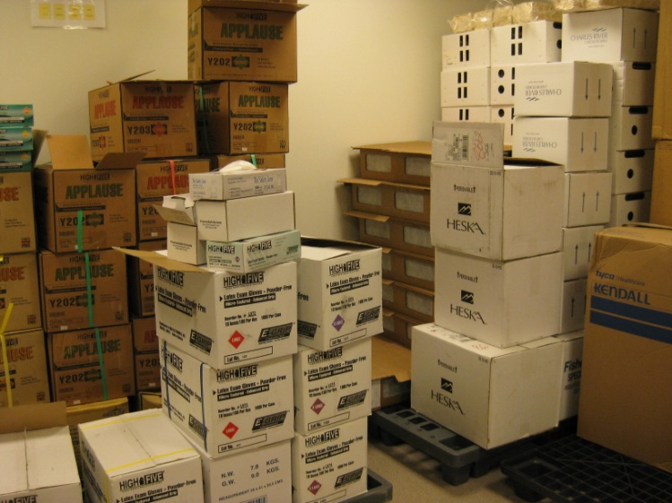
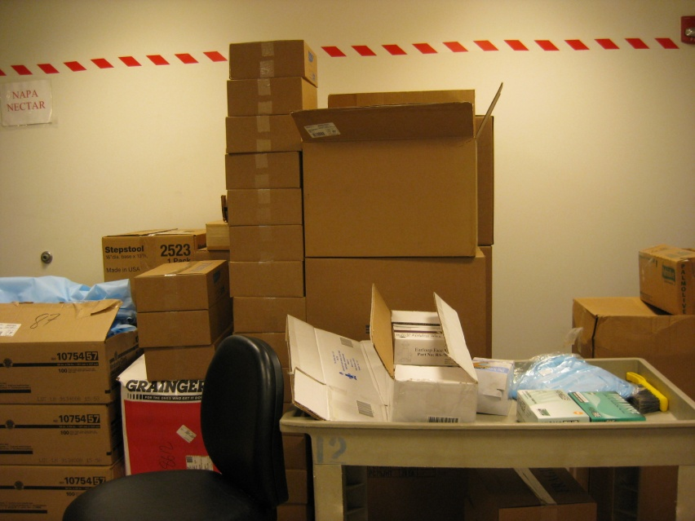
Results Can Be Obvious

Slide 10
Lean made easy peasy for beginners!
September, 2017

Slide 11
Pre-AALAS Lean Class in Austin Texas!
Yellow Belt Credits!
October, 2016

Slide 12
You can get Lean White Belt Certification Online!
October, 2017

Slide 13
VOE-Network
Yellow Belt Certification
Pilot: December, 2017

Slide 14
VOE-N
www.voenetwork.com

